Slide 1
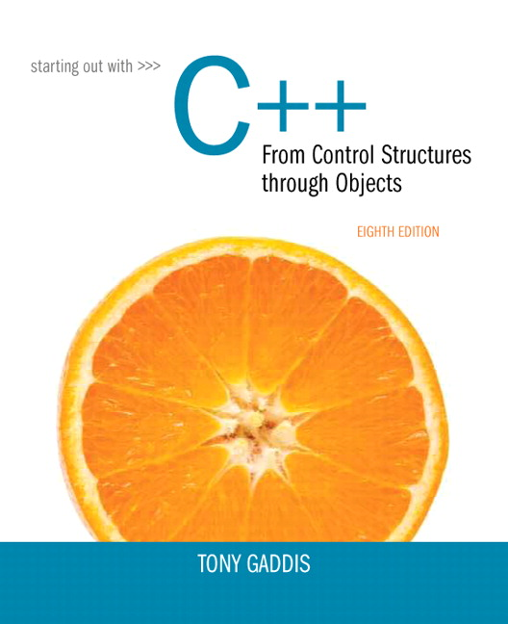
Chapter 3:
Expressions
and Interactivity

Slide 2
Section 3.1 – The cin Object
Do the Checkpoint problems on p87-88.
To see some of the problems that can occur when using cin, do the following:
Declare a string variable called name.
Display a prompt that asks the user for a name, and use cin to get the user’s response and put it in the variable name.
When the program runs, type in something like “Chuck Norris,” that is, a first name / last name combination with a space in the middle.
Print out the value of name to see what is in it. Did it capture all of the input that was typed in?
Include another cin statement into name followed by another output statement. What was printed out the second time?

Slide 3
Section 3.2 – Mathematical Expressions
Checkpoint p. 96-98.
Determine the values of the expressions in Checkpoint 3.7 (p96) by hand, and then write a C++ program that prints out those values to verify.

Slide 4
Section 3.3 – Type Conversion
Play with the integer division issue (p99) to learn about the different aspects of it.
Divide two integers, like 15 / 6 (p99), and print out the result.
Modify the program to assign the result of that division to a double variable and print that result.
Modify the program further to change the numerator from 15 to 15.0, assign the result to a double, and print the result.
Can you explain what is happening with each of these variations?

Slide 5
Section 3.4 – OverFlow and UnderFlow
Program 3-7 demonstrates overflow and underflow with a short. The variable was initialized with the largest possible value for that variable type. The program then added one to that variable, and, as you can see, the result was the smallest value possible for that data type. This is an example of overflow, because we attempted to store a value in the variable that was too large for it. Do the same experiment with an unsigned short. (Table 2-6 will tell you how to set the initial values.) Do the same experiment with signed and unsigned ints.
Was any kind of warning produced by the compiler when an integer variable overflows or underflows?

Slide 6
Section 3.5 – Type Casting
Checkpoint p103 -104.
Checkpoint 3.12 we’ve seen before. Write a program that gets a character from the user and prints that character’s ASCII value (by type casting to an int). Check that value against the ASCII table. (Chapter 2, S57).

Slide 7
Section 3.6 - Assignments
Checkpoint p 107. (All of these are good practice.)

Slide 8
Section 3.7
Practice with these manipulators! Work with CheckPoint, pp117-118.
What happens when both of the manipulators, fixed and showpoint, are used together? Does setprecision() operate in decimal point mode or in significant figures mode?
Checkpoint 3.17. Display the number 34.789 in a field of nine spaces with two decimal places of precision.
Make it left justified.
Replace fixed with showpoint, leaving the setprecision value the same. What is the result?

